Slide 1
Trends in employment data
References:
Chapter 4, Williamson
McGratten and Rogerson, Changes in Hours Worked
FRED

Slide 2
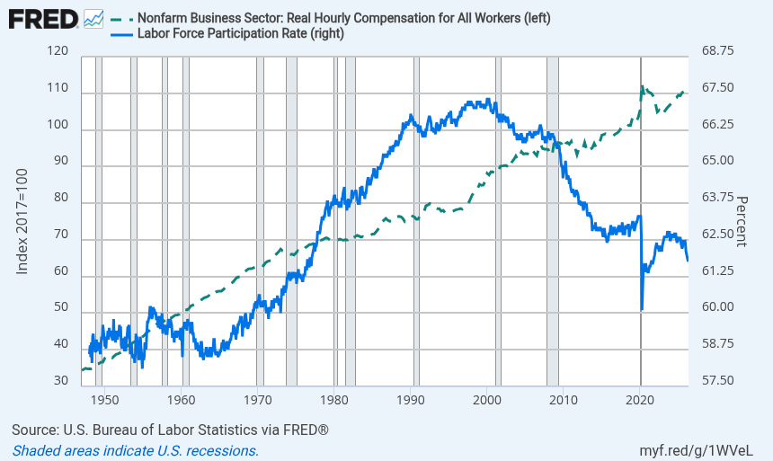
Movements at the extensive margin seem driven by something other than real returns to employment

Slide 3
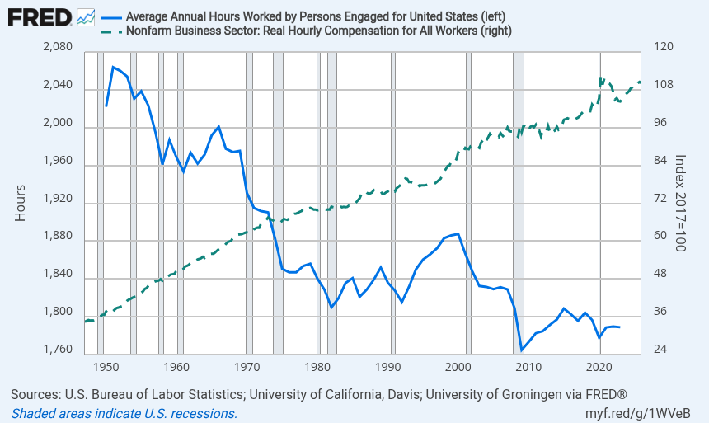
Income effects appear to dominate substitution effects at the intensive margin over long periods of time

Slide 4
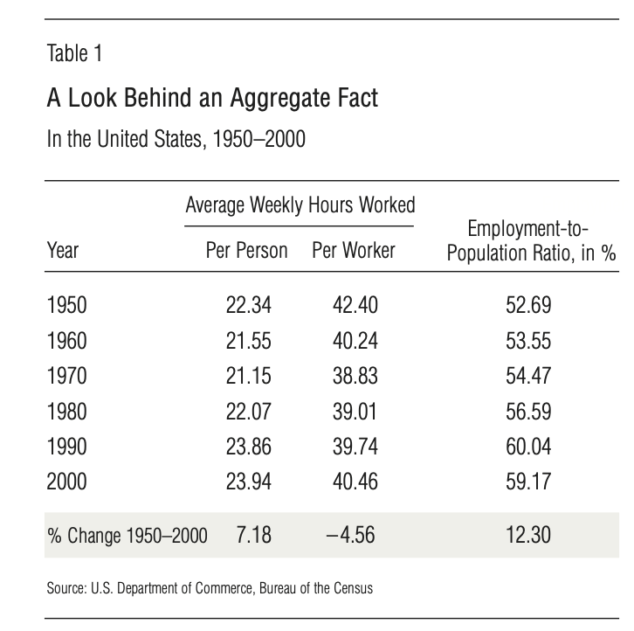
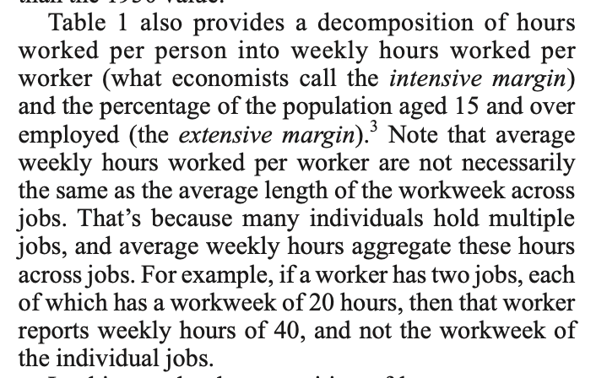
But average annual hours is not the same as hours per worker (Mcgratten and Rogerson). Hours per worker has only fallen 5%:

Slide 5
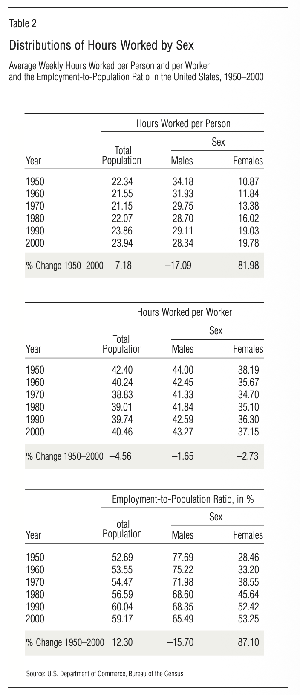
Most of the small remaining aggregate dynamics at the intensive margin are compositional effects, as women, who work on average fewer hours, make up more of the labor force.

Slide 6
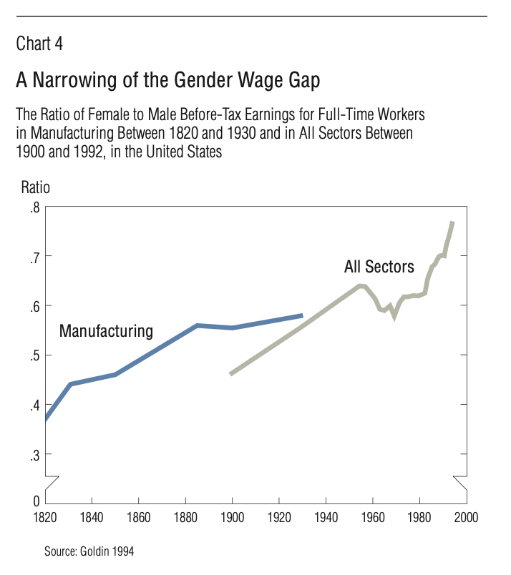
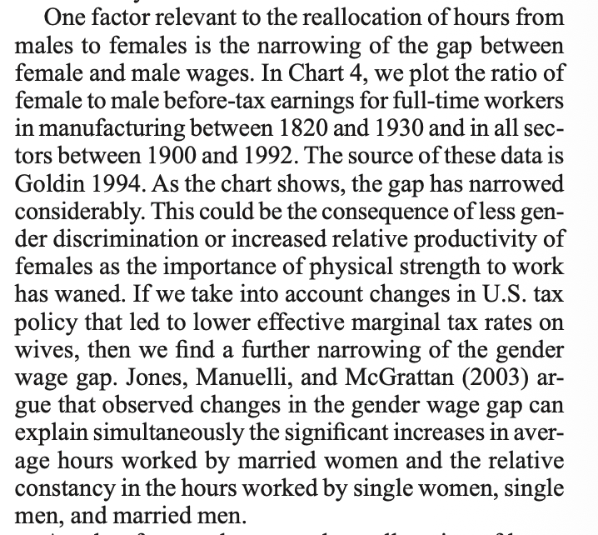
Increased female labor force participation may reflect strong female-specific after-tax real wage increases (substitution effect)

Slide 7
Summary so far:
A breakdown of the aggregate intensive margin data could be interpreted as either
Little-to-no sensitive of hours worked to changes in total real compensation (income and substitution effects cancel over the long run), or
Substitution effects being strong enough to dominate income effects for women, reflecting greater gender equality in the workforce as well reduction of the “marriage tax” in the US tax code.

Slide 8
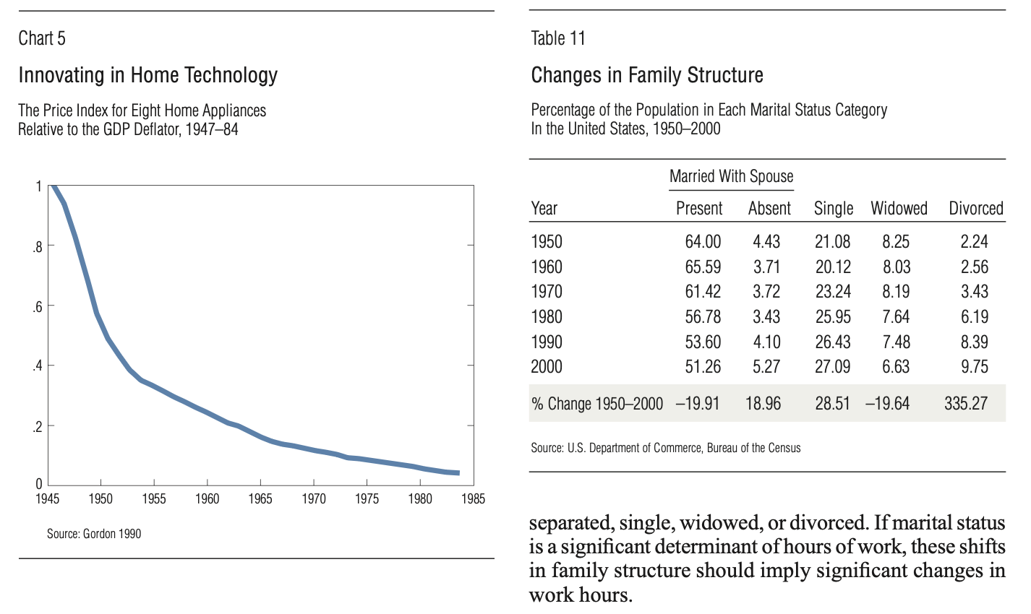
Increased female labor force participation may reflect a higher relative weight on “C” in female utility

Slide 9
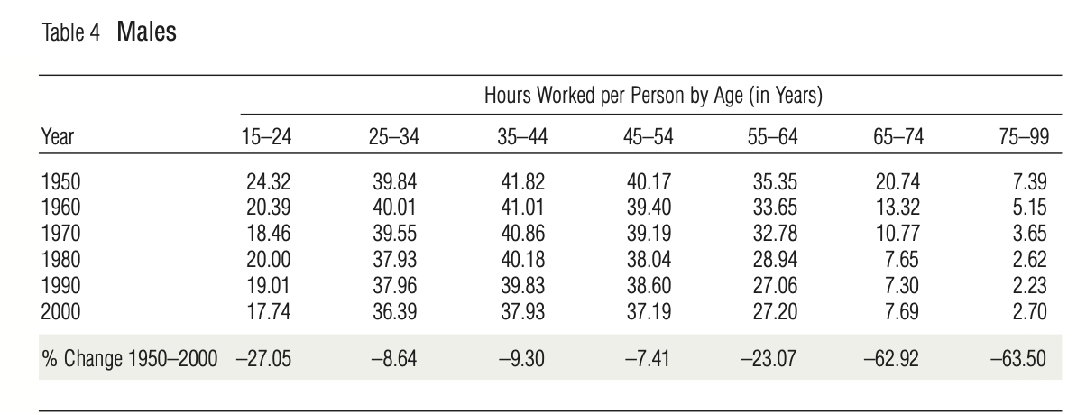
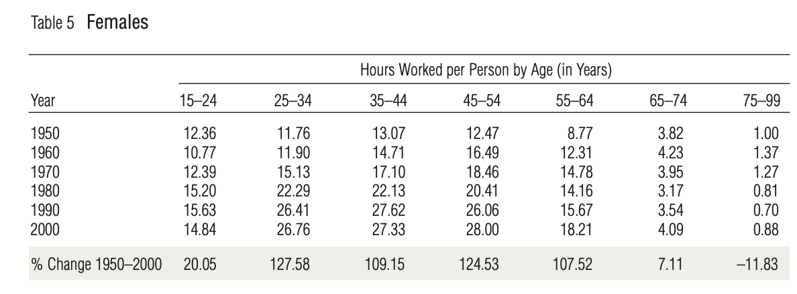
At the extensive margin, there has been a shift in the age of people at work, with more young women working and fewer older men working

Slide 10
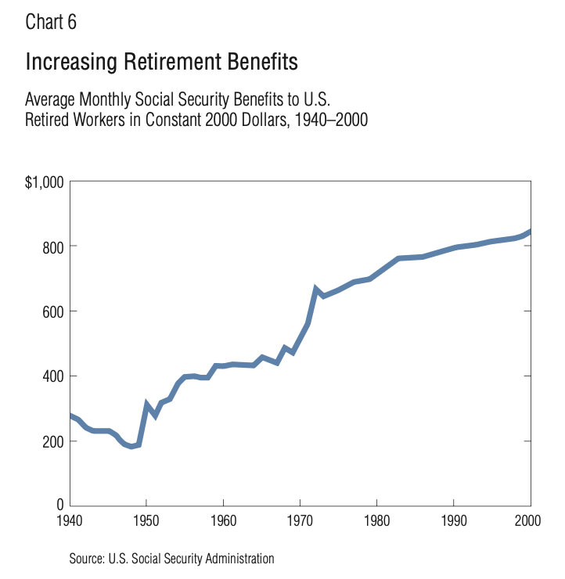
Lower older-age participation, especially among men, may reflect higher retirement benefits (income effect)

